Slide 1

Intro to object-oriented programming
Chapter 8 – Encapsulation

Slide 2
Encapsulation
The first of the three main tenets of object oriented programming is encapsulation.
This word might conjure up an image of a space capsule, a cell wall, or a medicine gelcap, where the precious cargo inside is protected from the outside environment. In programming, encapsulation has a similar but even more detailed meaning: hiding internal details of state and behavior from any external code and having all code in one place.

Slide 3
Encapsulation with Functions
Functions are a prime example of encapsulation because when you call a function, you generally don’t care how the function works internally. A well written function contains a series of steps that make up a larger single task, which you do care about. The name of the function should describe the action that its code embodies.
Consider the built-in len() function from the Python Standard Library, used to find the number of characters in a string or elements in a list. You pass in a string or list, and it returns the count. When you write code that calls this function, you don’t care how len() does what it does. You don’t stop to think about whether the code of the function contains two lines or two thousand lines, whether it uses one local variable or a hundred. You just need to know what argument to pass in and how to use the result that’s returned.
The same is true of functions that you write, like this function that calculates and returns the average of a list of numbers. Once you’ve tested a function like this and found that it works, you no longer have to worry about the details of the implementation. You only need to know what argument(s) to send into the function and what it returns.
However, if one day you find that there is a much simpler or faster algorithm to calculate an average, you could rewrite the function in a new way. As long as the interface (the inputs and outputs) does not change, there is no need to change any calls to the function. This type of modularization makes the code more maintainable.

Slide 4
Encapsulation with Objects
Unlike variables used in regular functions, instance variables in objects persist across different method calls. To keep the remaining discussion clear, I’ll introduce a new term: client. (I don’t want to use the term user here since that typically refers to the human user of the final program.)
Client - Any software that creates an object from a class and makes calls to the methods of that object.
We must also consider the duality of inside versus outside an object or class. When you’re working inside a class (writing the code of the methods in a class), you need to concern yourself with how the different methods of the class share the instance variables. You consider the efficiency of your algorithms. You think about what the interface should look like: what methods you should provide, what the parameters for each are, and what should be used as default values. In short, you are concerned with the design and implementation of the methods.
From the outside, as a client programmer, you need to know the interface of the class. You’re concerned with what the class methods do, what arguments should be passed in, and what data is passed back from each method
A class therefore provides encapsulation by:
Hiding all details of implementation in its methods and instance variables
Providing all the functionality a client needs from an object through its interface (the methods defined in the class

Slide 5
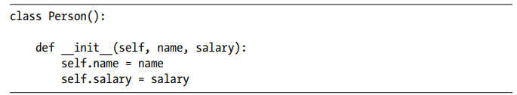
Objects Own Their Data
In object-oriented programming, we say that the data inside an object is owned by the object. OOP programmers generally agree that, as a good design principle, client code should only be concerned with the interface of a class and should not care about the implementation of the methods.
The values of the instance variables self.name and self.salary are set whenever we instantiate new Person objects, like this:
Each Person object owns its own set of the two instance variables.

Slide 6
Interpretations of Encapsulation
Here is where things get a little controversial. Different programmers have different views about the accessibility of an instance variable. Python provides for a loose interpretation of encapsulation by allowing direct access to instance variables using simple dot syntax. Client code can legally access an instance variable of an object by name using the syntax <object>.<instanceVariableName>.
However, a strict interpretation of encapsulation says that client software should never be able to retrieve or change the value of an instance variable directly. Instead, the only way that a client can retrieve or change a value held in an object is to use a method provided by the class for this purpose.

Slide 7
Direct Access and Why You Should Avoid It
Examples....

Slide 8
Strict Interpretation with Getters and Setters
The strict approach to encapsulation says that client code never accesses an instance variable directly. If a class wants to allow client software to access the information held inside an object, the standard approach is to include a getter and a setter method in the class.
Getter - A method that retrieves data from an object instantiated from a class.
Setter - A method that assigns data into an object instantiated from a class.
Getter and setter methods are designed to allow writers of client software to get data from and set data in an object, without needing explicit knowledge of the implementation of a class—specifically, without having to know or use the name of any instance variable.
EXAMPLE: Person.py

Slide 9
Safe Direct Access
There are certain circumstances where it seems reasonable to access instance variables directly: when it is absolutely clear what the instance variable means, little or no validation of the data is needed, and there is no chance that the name will ever change. A good example of this is the Rect (rectangle) class in the pygame package. A rectangle in pygame is defined using four values—x, y, width, and height—like this:
After creating that rectangle object, using oRectangle.x, oRectangle.y, oRectangle.width, and oRectangle.height directly as variables seems acceptable.

Slide 10
Making Instance Variables More Private
In Python, all instance variables are public (that is, can be accessed by code external to the class). But what if you want to allow access to some of your class’s instance variables, but not all of them? Some OOP languages allow you to explicitly mark certain instance variables as public or private, but Python doesn’t have those keywords. However, there are two ways that programmers who develop classes in Python can indicate that their instance variables and methods are intended to be private.

Slide 11


Implicitly Private
To mark an instance variable as one that should never be accessed externally, by convention you start the name of your instance variable with one leading underscore:
Instance variables with names like these are intended to represent private data, and client software should never attempt to access them directly. The code may still work if the instance variables are accessed, but it is not guaranteed.
The same convention is used for method names:
Again, this is only a convention; there is no enforcement. If any client software makes a call to a method with a name beginning with an underscore, Python will allow it, but there is a good chance that doing so will lead to unexpected errors.

Slide 12
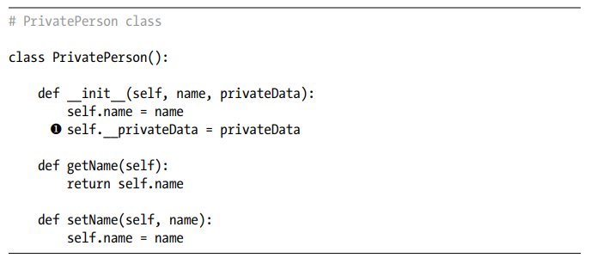
More Explicitly Private
Python does allow for a more explicit level of privatization. To disallow client software from directly accessing your data, you create an instance variable name that starts with two underscores.
Suppose we create a class named PrivatePerson with an instance variable self.__privateData that should never be accessed from outside an object
instance variable directly from client software, like this:
will generate an error:

Slide 13
MORE EXPLICITLY PRIVATE
We can then create a PrivatePerson object, passing in some data that we wish to keep private. Attempting to access the __privateData instance variable directly from client software, like this:
will generate an error:
Similarly, if you create a method name that starts with two underscores, any attempt by client software to call the method will generate an error.

Slide 14

Decorators and @property
At a high level, a decorator is a method that takes another method as an argument and extends the way the original method works. (Decorators can also be functions that decorate functions or methods, but I’ll concentrate on methods.) Decorators are an advanced topic and are generally beyond the scope of this course. However, there is a set of built-in decorators that provide a compromise between direct access and the use of getters and setters in a class.
A decorator is written as a line that starts with the @ symbol followed by a decorator name and is placed directly before the def statement of a method. This applies the decorator to a method to add to its behavior:
We’ll use two built-in decorators and apply them to two methods in a class to implement a property.
Property - An attribute of a class that appears to client code to be an instance variable, but instead causes a method to be called when it is accessed.

Slide 15
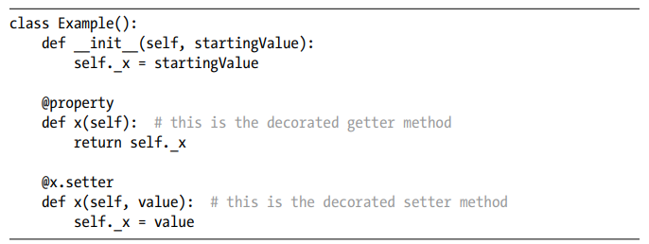
DECORATORS AND @PROPERTY
A property allows class developers to use indirection, the way that a magician uses misdirection—the audience thinks they are seeing one thing, while behind the scenes something very different is happening. When writing a class to use property decorators, the developer writes a getter and a setter method and adds a distinct built-in decorator to each one. The first method is a getter and is preceded with the built-in @property decorator. The name of the method defines a name of a property to be used by client code. The second method is a setter and is preceded with the @<name of the property>.setter decorator
Here is a minimal sample class:

Slide 16
Video summary
Encapsulation - Advanced Python Tutorial #5 - YouTube

Slide 17
Abstraction
Abstraction is another OOP concept closely related to encapsulation; many developers consider it to be the fourth tenet of OOP.
Whereas encapsulation is about implementation, hiding the details of the code and data that make up a class, abstraction is about the client’s view of a class. It’s about the perception of a class from the outside.
Abstraction - Handling complexity by hiding unnecessary details.
Essentially, abstraction is a reminder to make sure that the user’s view of a system is as simple as possible.
Abstraction is extremely common in consumer products. Many people use TVs, computers, microwave ovens, cars, and so on every day. We become comfortable with the user interface that these products extend to us. Through their controls, they provide an abstraction of their functionality. You press the accelerator pedal in a car to make it go forward. With a microwave, you set an amount of time and press Start to heat up some food. But few of us really know how these products work internally.

Slide 18
ABSTRACTION
Here’s an example of abstraction from the world of computer science. In programming, a stack is a mechanism for remembering data in a last in, first out (LIFO) order. Think of a pile of plates, where clean plates are added to the top and users take one from the top when they need a plate. A stack has two standard operations: push adds an item to the top of the stack, and pop removes the topmost item from the stack.
A stack is particularly useful whenever your program does any navigation because it can be used to leave a trail of breadcrumbs for finding your way back. This is how programming languages keep track of the execution of function and method calls in code: when you call a function or method, the return point is pushed onto a stack, and when the function or method returns, the place to return to is discovered by popping the most recent information off the top of the stack. In this way, code can make as many levels of calls as you need, and it always unwinds correctly.

Slide 19
abstraction
As an abstraction, suppose a client program required the functionality of a stack that would be simple to create and would provide the ability to push and pop information. If this were written as a class, the client code would create a stack like this:
A client would add information by calling a push() method like this:
And it would retrieve the most recent data by calling a pop() method like this:
The client would not need to know or care how these methods were implemented or how the data was stored. The implementation of the Stack would be handled completely by the methods of the Stack.

Slide 20
Summary
Encapsulation is the first major tenet of object-oriented programming, allowing classes to hide their implementation and data from client code and ensuring that a class provides all the functionality that a client needs in a single place.
A key concept of OOP is that objects own their data, and that’s why I recommend that you provide getter and setter methods if you want client code to access the data held in an instance variable. Python does allow direct access to instance variables using dot syntax, but I strongly encourage you to stay away from this syntax for the reasons laid out in this chapter.
There are conventions for marking instance variables and methods as private, using a leading underscore or double underscore depending on the level of privatization you require. As a compromise, Python also allows the use of the @property decorator. This makes it appear as if the client code is able to access an instance variable directly, while behind the scenes Python turns such references into calls to the decorated getter and setter methods in the class.
The pygwidgets package provides many good examples of encapsulation. As a client programmer, you see a class from the outside and work with the interfaces that the class provides. As a class designer, abstraction—handling complexity by hiding details—helps you design a good I nterface by considering the interface of the class from the client’s point of view. However, in Python, you often have the source code available so that you can look at the implementation if you wish.

